Slide 1

Medical Image Segmentation Using Deep Learning
A Project given by
Bhabha Atomic Research Center(BARC)
(15TH Jan 2020 – 15th June 2020)
for the partial fulfillment of B.Tech degree
Submitted by: Submitted to:
Name – Tanusha Shrivastava Prof. Sachin Solanki
Medicaps University, Indore Assistant Professor
Enrollment no.- EN16CS301278 Computer Science Department
Medicaps University,Indore
External guide: Ms. Janhavi Deshpande

Slide 2
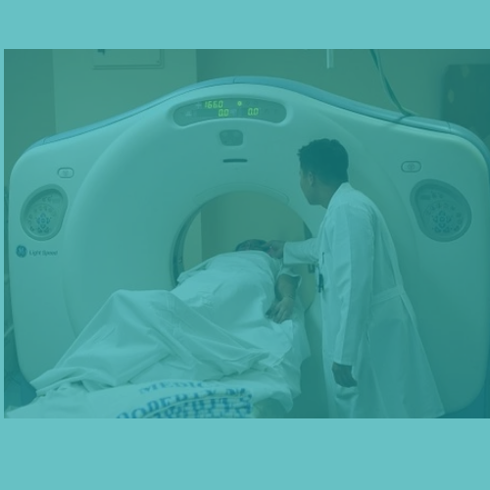
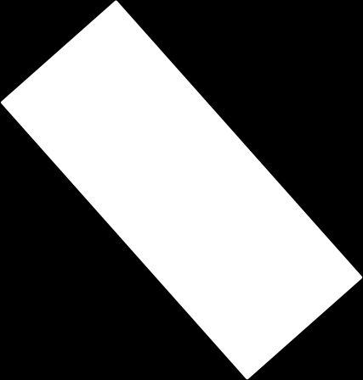
Contents
INTRODUCTION
CONTENT
DATASET
RESULTS
LEARNING NEW APPROACH
FUTURE SCOPE

Slide 3
INTRODUCTION

Slide 4
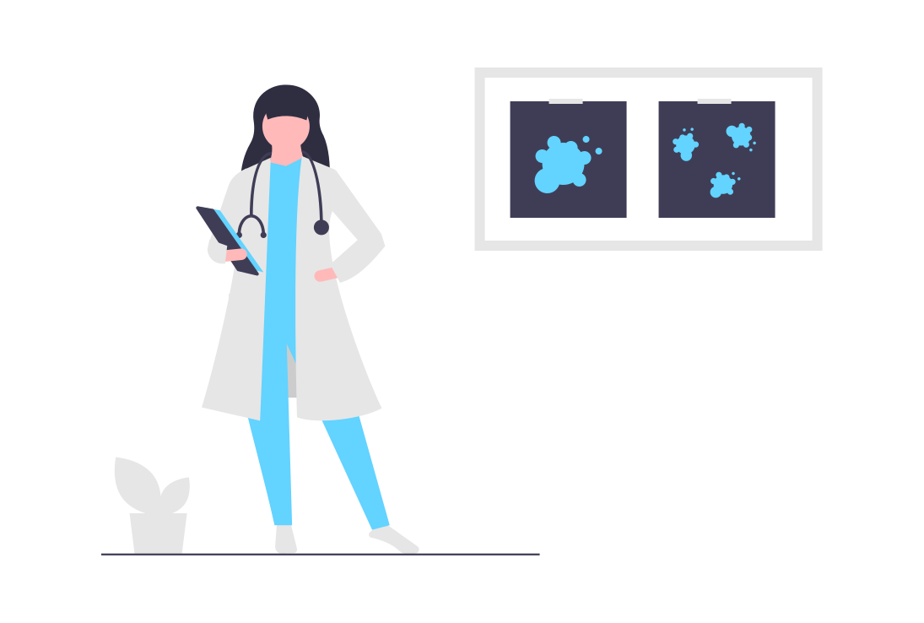


Human body or Tumor??
It’s Lungsd
Easy peasy

Slide 5
What is Medical Image Segmentation?
Extracts the region of interest (ROI)
Divides an image into areas based on a specified description.
The goal of segmentation:
Simplify or change the representation of an image into something that is more meaningful and easier to analyze.
Image segmentation is typically used to locate objects and boundaries (lines, curves, etc.) in images

Slide 6
CONCEPT

Slide 7
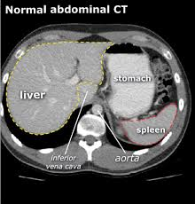

Aim of Segmentation
Identify Region of Interest
Measure tissue volume to measure growth of tumor
Study anatomical structure

Slide 8
Methods of Segmentation
Segmentation
Region based Segmentation
Neural Network based Segmentation
Segmentation based on Clustering
Edge based Segmentation
Neural Network based Segmentation
This project is mainly concerned with Neural Network based Segmentation.

Slide 9
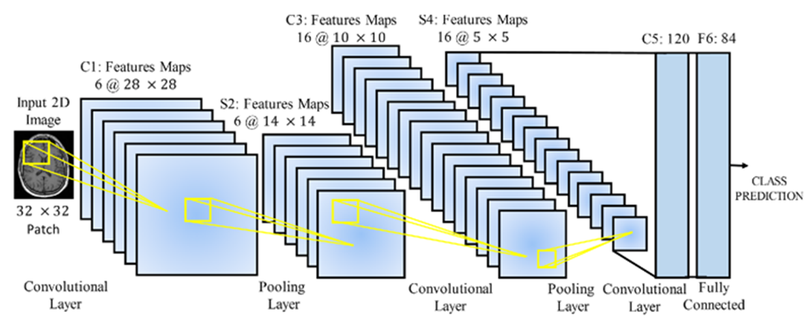
Convolutional Neural network (CNN)
Specific type of artificial neural network.
Apply to image processing, natural language processing and other kinds of cognitive tasks.
It contains 5 types of layers:- Input Layer, Convolutional Layer, Activation function layer, Pooling Layer and Fully Connected layer.

Slide 10
U Net Architecture
The U-Net architecture stems from the so-called fully convolutional network
U-Net architecture consists of two sections:
Contraction Section
Expansion section.
The first half of the network minimizes a cost function and the second half of it constructs an image of the targeted segment

Slide 11
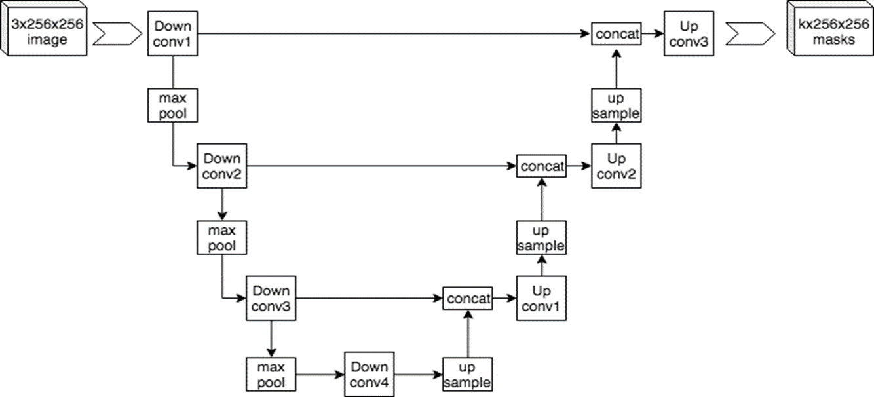

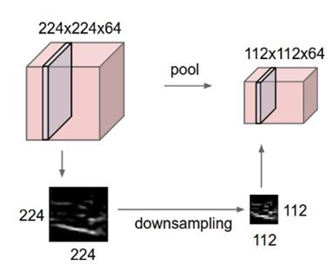
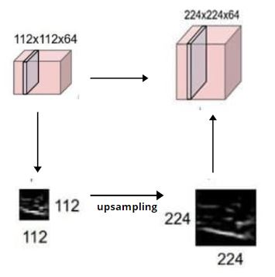
Layers in U-Net Architecture

Slide 12
DATASET

Slide 13
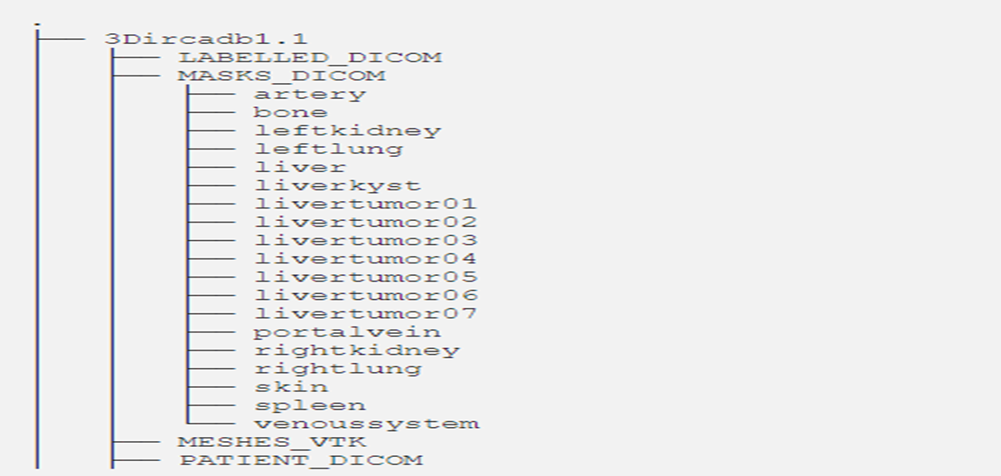
Data Set in the project
The database is composed of the 3D CT-scans of 10 women and 10 men with hepatic tumors in 75% of cases. The 20 folders correspond to 20 different patients.
These folders are called 3D-IRCADb-1-number. Each 3D-IRCADb-01-number folder contains sub-folders called PATIENT_DICOM and MASKS_DICOM.
Source: https://www.ircad.fr/research/3d-ircadb-01/

Slide 14
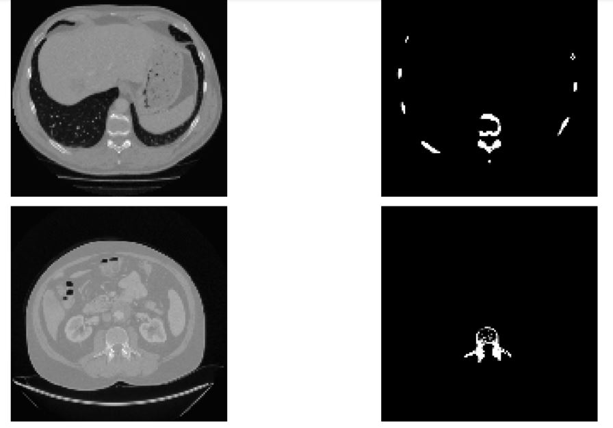
Snapshot of data of the project
CT Scan images(Top cross-section) of abdominal region used for training
Bone images from labelled data

Slide 15
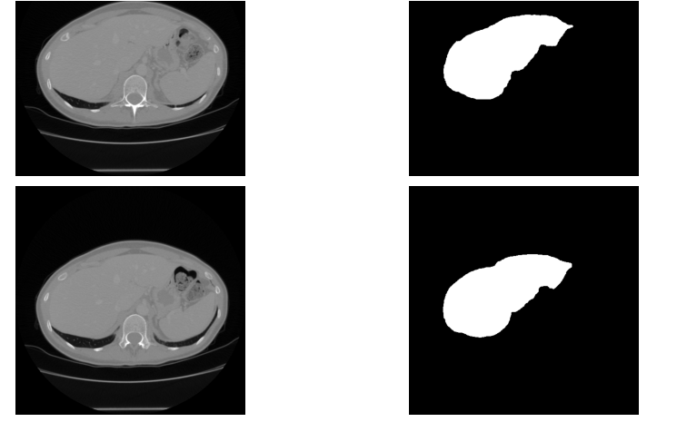
Snapshot of data of the project
CT Scan images(Top cross-section) of abdominal region used for training
Liver images from labelled data

Slide 16
RESULTS

Slide 17
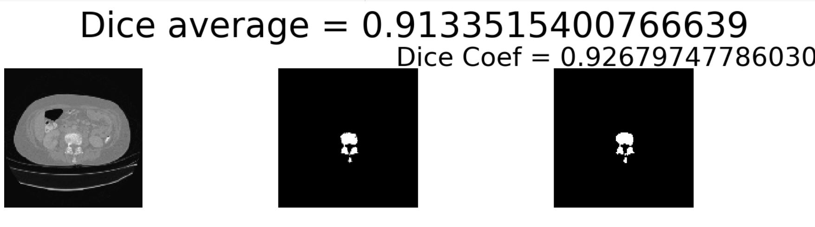
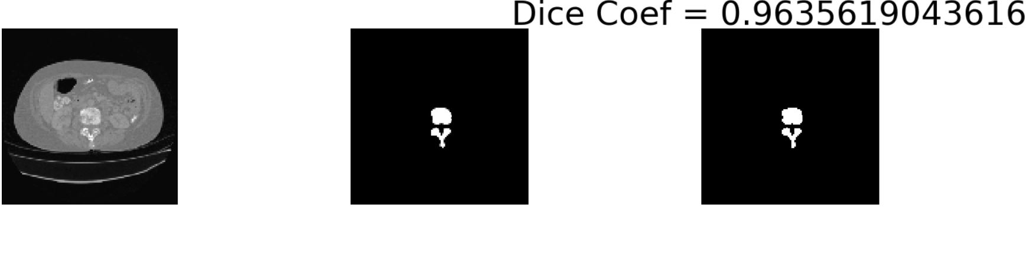
Snapshot of Segmented Image
Original CT Scan image
Labelled bone image
Segmented bone image generated by 10-layer U-Net model.

Slide 18
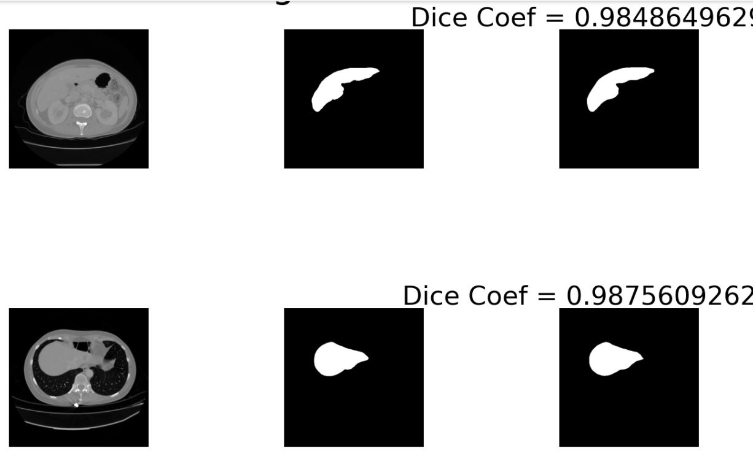
Snapshot of Segmented Image
Labelled image of liver
Segmented liver image generated by10-layer U-Net model.
Original CT Scan image

Slide 19
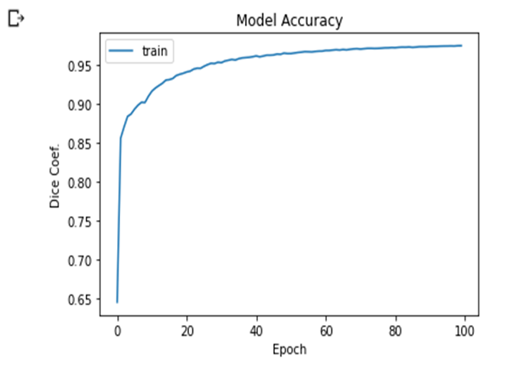
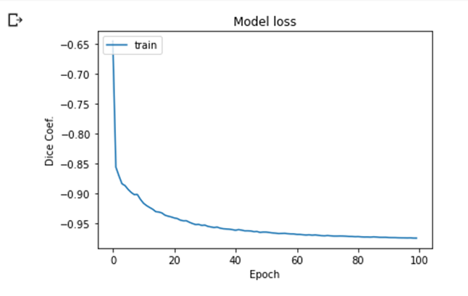
Graph of Trained Model
Model is trained with:
Batch size: 16
No. of epoch: 100

Slide 20
VARIATION OF SOME IMAGES WITH THE ACTUAL
The left image is the predicted image and the right image is the actual image

Slide 21
LEARNING NEW APPROACH

Slide 22
Transfer Learning
Transfer learning make use of the knowledge gained while solving one problem and applying it to a different but related problem.
Examples include:
Know how to ride a motorbike Learn how to ride a car
Know how to play classic piano Learn how to play jazz piano
Know math and statistics
Learn machine learning
In this project, transfer learning is applied by taking model of ‘bones data’ to predict liver segmentation which is then compared with a trained model for liver segmentation done from scratch.

Slide 23
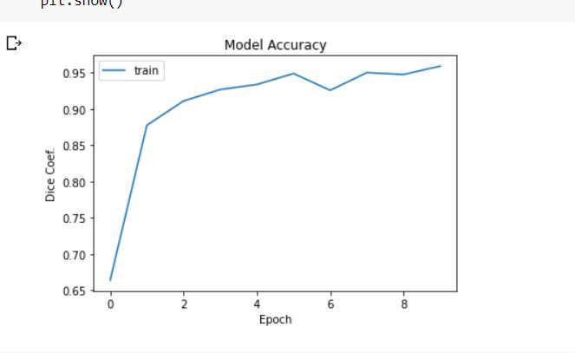
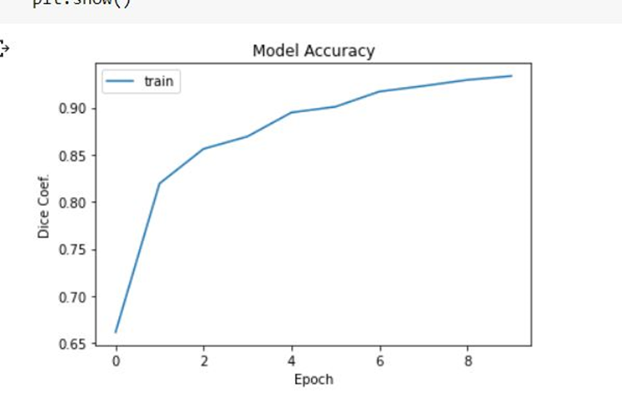
Graph of Models with 10 epoch
Transfer Learning Model (liver data)
Model trained from scratch(liver data)
Accuracy value as 97% with 562 samples
Accuracy value as 95% with 1622 samples

Slide 24
Comparison
Transfer learning liver model
Traditional learning liver model
Trained with 562 samples of liver data
Better accuracy value
Already learned to identify basic image component i.e. lines, corners, intensity variations from previously trained models
Reduces training time
Helpful for lesser amount of data
Trained with 1622 samples of liver data
Less accuracy value
Learn to classify images for the very first time.
Would take more time to learn
Need large amount of data.

Slide 25
FUTURE SCOPE

Slide 26
Future Scope
Creating more interactive output: Labelling every part in an image may give clear identification of the output image.
Segmentation of more parts: Since the model is trained on some specific body parts, the project would be better if it can segment a greater number of parts.
Improving algorithm: We have to improve our algorithm to achieve far better results on a far better dataset.

Slide 27

Thank You

